Slide 1
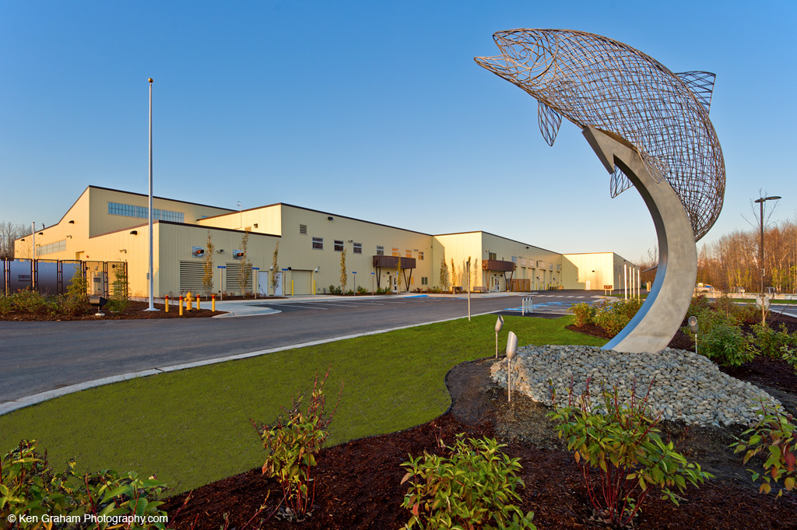
Dave Kemp, P.E., PMP State of Alaska Scott Davis, Kiewit Building Group Inc.
Construction Manager / General Contractor
Notes:
40 Years of Managing Projects-Avid duck hunter but even the best trained teams sometime mess up….

Slide 2
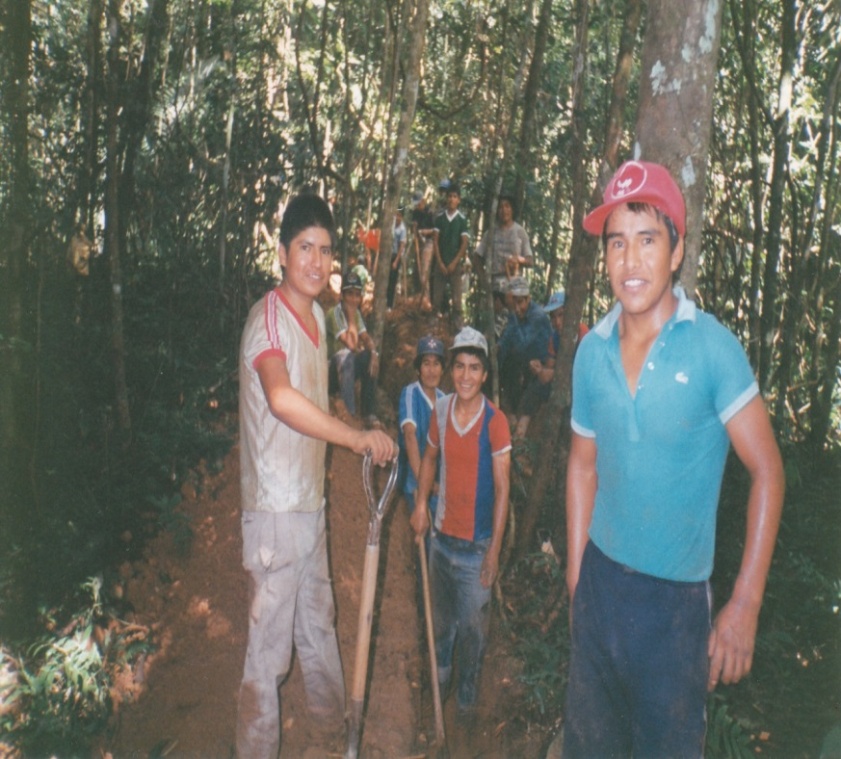
Swaziland-1981-1984 Bolivia 1989-1991
Notes:
Started my career in 1981-1984-working as a volunteer for the Rural Water Supply Board of Swaziland

Slide 3
Problems will arise

Slide 4
SoCal 1995
Notes:
Before I started with Kiewit in 1995, I knew I loved construction. I spent 5 years as a successful swimming pool designer / builder. Wanting more I left the pool business to attend Cal Poly Pomona for an Engineering Technology degree. Projects After WWTP in LA >>>>

Slide 5
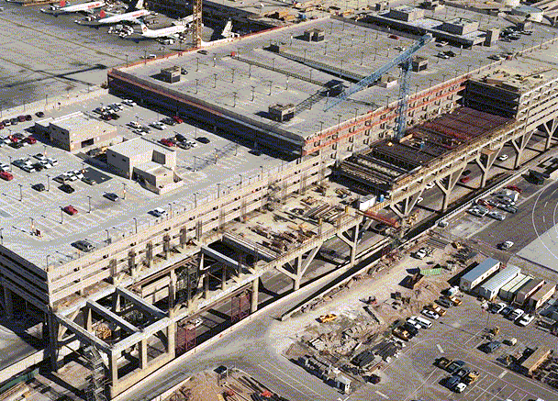
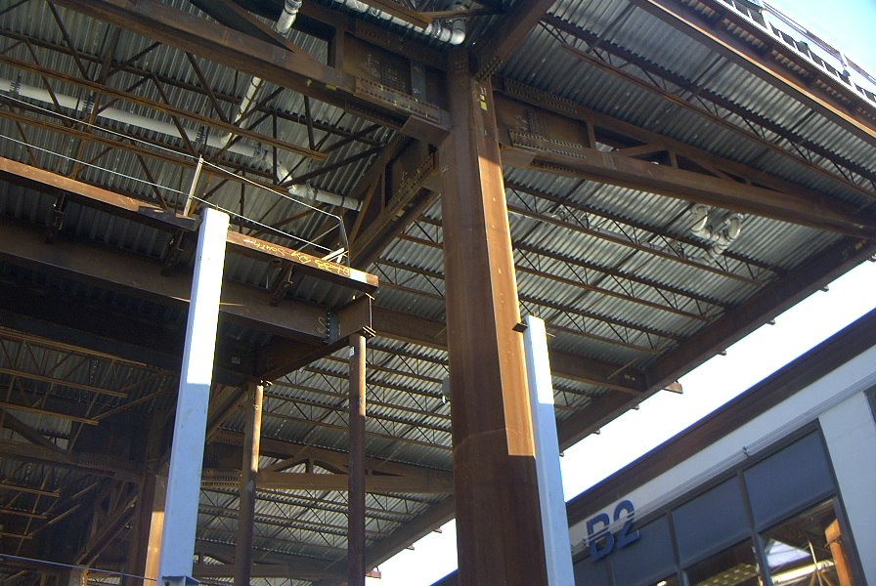
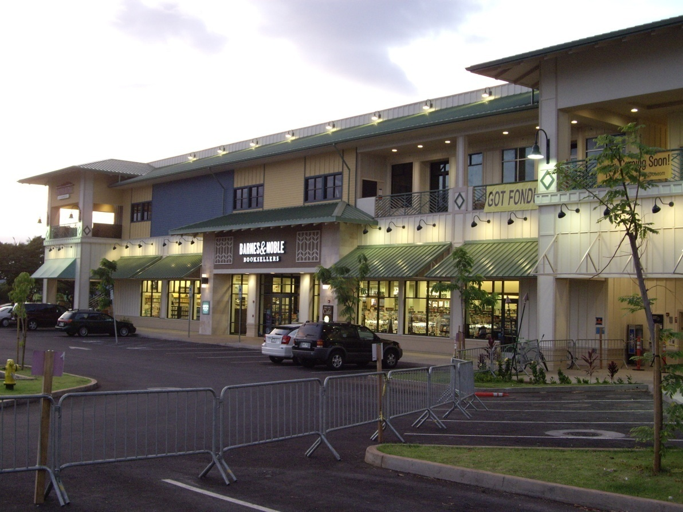
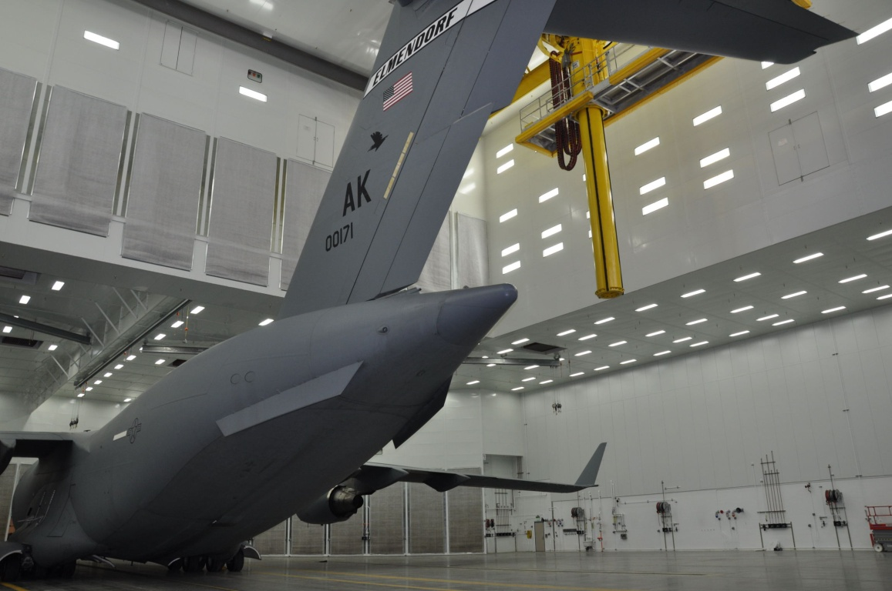
I Enjoyed My Relocations
Phoenix, AZ
Anchorage, AK
Flagstaff, AZ
Lahaina, HI
Anchorage, AK
Notes:
Phoenix – Sky Harbor Terminal 4 Expansion,
Anchorage – Concourse C and Arrivals Hall
Northern AZ to complete a Land Art project for James Turrell
Maui – Lahaina Gateway
And Back to Anchorage for C-17 Hangars at JBER and then one of my career favorite projects>>>>

Slide 6
CM/GC Delivery of Alaska Ferries

Slide 7
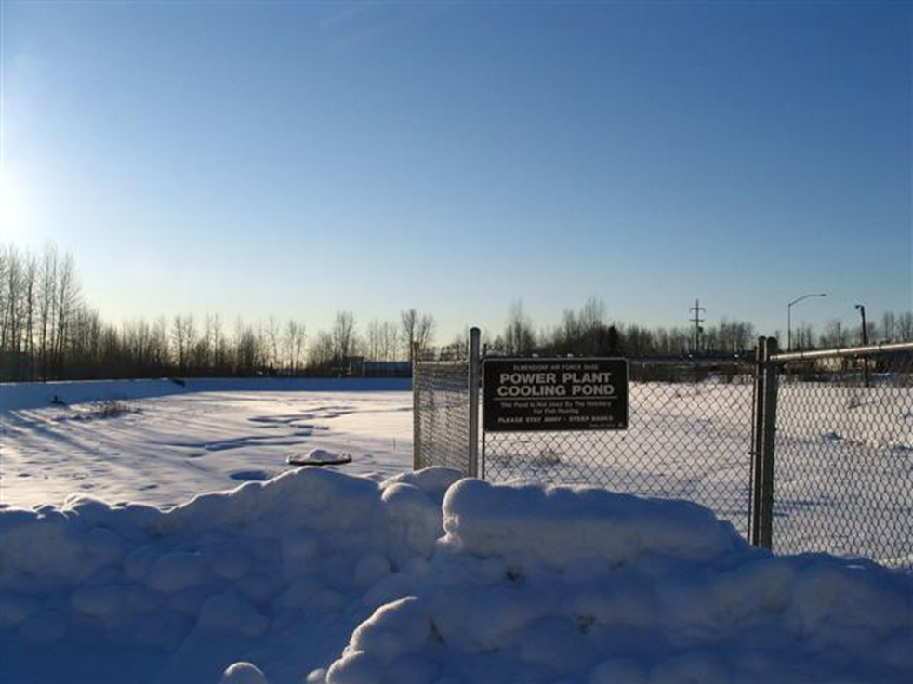
William Jack Hernandez Sport Fish Hatchery & CM/GC
Power Plants closed
Loss of Heated Water
Need for more efficient Hatcheries

Slide 8
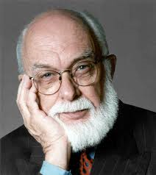
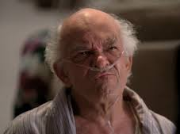
First Meeting with Client-ADF&G
Complexities Led to CM/GC
Schedule
Budget
Scope
Two guys in the back…
Notes:
So Mr. Kemp how many hatcheries have you built in your career?

Slide 9
William Jack Hernandez Sport Fish Hatchery
141,000 SF 200’ X 600’-Largest Hatchery of it’s kind in North America
107 Fish rearing Tanks-8.5 miles of pipe, conduit and ducts
Chinook, Coho, Rainbow, Arctic Char, Arctic Graying
6 million fish each year stocked in 200 different locations
Gray Field/Brown Field site of former Elmendorf Powerhouse cooling pond
Finalist America Society of Civil Engineers Outstanding Engineering Achievement
American Council of Engineering Companies-Engineering Excellence Award
Peg and Jules Tileston Award for Economic Development and Environmental Stewardship
First project in the world to be awarded the ISI Envision Certified Project
Utilized the Construction Manager/General Contractor method of procurement
Notes:
I was the PM for this project

Slide 10
William Jack Hernandez Sport Fish Hatchery
Notes:
As a company, Kiewit performs ~$2.5 Billion annually using CM/GC delivery method, or 25%.
Within the vertical building market under Kiewit Building Group since 2009, 80% are CM/GC or Construction Manager at Risk (CMAR). That being said, the current trend is from CM/GC to Design/Build, which offers clients a single point of contact, design oversight, and more accountability with cost escalation in design.

Slide 11
Contractor Added Value

Slide 12
What did CM/GC bring to our Project: The Owners Point of View
1) Entire Team formed early
2) Contractor understood needs of client
3) Contractor was part of the planning and design process
a) Contractor provided alternative construction methods, materials and scheduling options
b) Contractor provided Owner with a separate and experienced voice
c) Contractor was part of the scope=budget balance process
4) Owner was provided with a GMP early in the process
5) Contractor was selected mainly on the basis of their past performance and their project team. While price was a consideration, it was not a major factor.
6) Issues such as aquaculture activities starting in a section of the hatchery while construction activities were still ongoing on the overall hatchery were identified early and were planned and executed in a well though out manner

Slide 13
What did CM/GC bring to our Project: The Contractors Point of View
GC is an early participant of the project team, and selected mainly on the basis of their past performance and ability to become a trusted partner.
Contractor hears first hand what the needs of client are.
Contractor participates in the initial planning and is interactive within the early design process:
Owner was provided with a GMP early in the process
Contractor. While price was a consideration, it was not a major factor
Issues such as aquaculture activities starting early in a section of the hatchery while construction activities were still ongoing on the overall hatchery were identified early and were planned and executed in a well though out manner
In progress still…
Notes:
3.
Contractor experience provides alternative construction methods or materials.
Scheduling and sequence of operations options for desired result.
Contractor provided Owner with a unique and experienced voice.
Contractor was part of the scope vs. budget balance process

Slide 14
Contaminated Soils
Notes:
When ADOF&G took the site to become lawfully we to the property, it did so knowing that you get what you get on ex military property. In this case was the potential of unsuitable and/or contaminated soils.
Kiewit, DOT, and our Environmental/Soils Engineers worked shoulder to shoulder to developed a plan to mitigate fuel contaminated soils. Instead of finger pointing, we all worked together to minimize impacts to the project. In lieu of exporting everything we found, we work together and stocked piles and maintained spreads to get soils to an acceptable state to enable its re-use. With the footprint of the 141,000 SF structure, miles of underground pipe to install, there was not extra room to do this, but we were able to find areas where the soils could be done. Team brainstorming to find the best sequencing and strategy won in the end, and we all knew we saved lots of contingency by working together, and ultimately to saved the client funds that could be used to get some added scope paid for in the end.

Slide 15
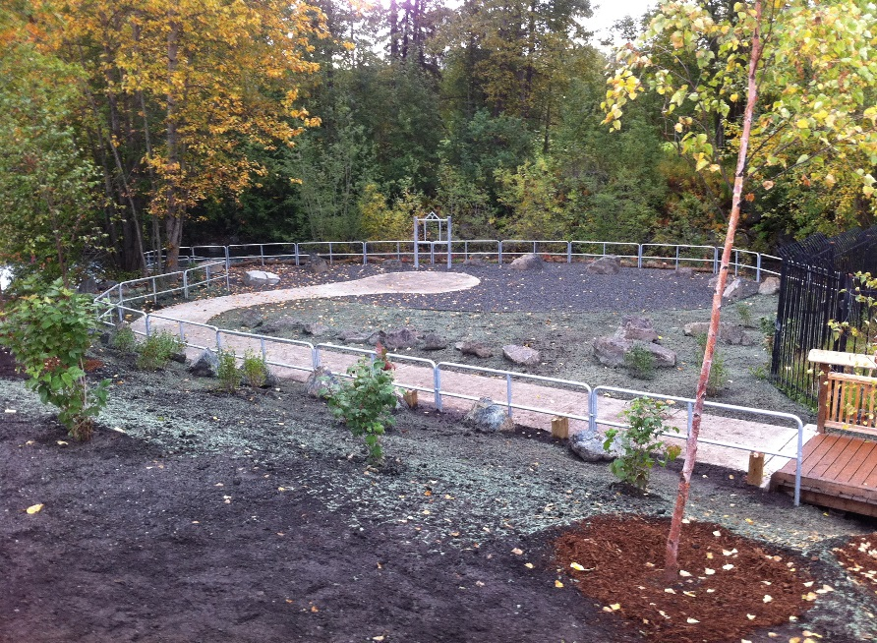
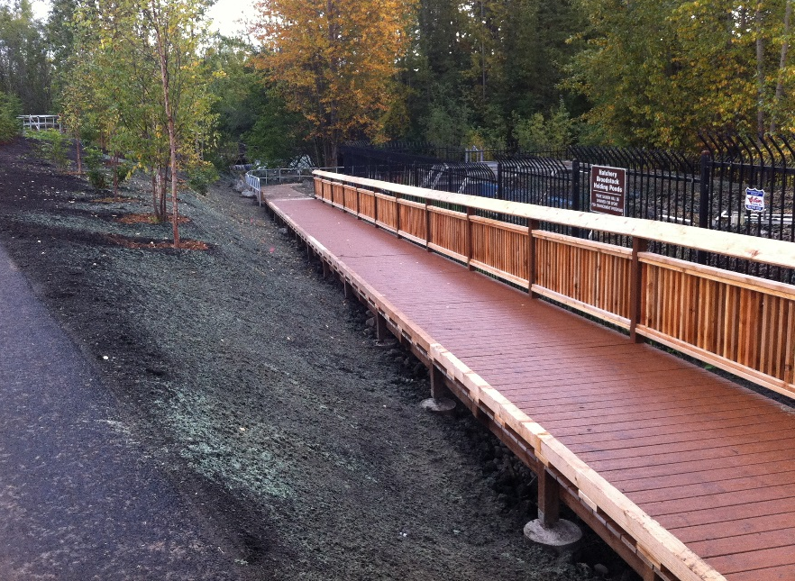
New Scope with Savings
Notes:
With the project nearing completion, we found that budget that was not used, and we were able to remove old concrete raceways, and replace with a visitors parking lot, construct an exterior viewing deck at the Creekside raceways, add park like features and a wandering walking path through new landscaped areas between the new hatcher and the creek.

Slide 16
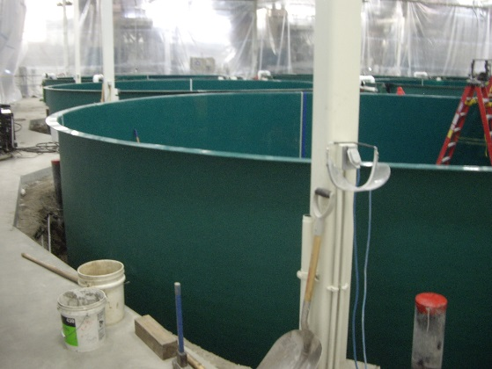
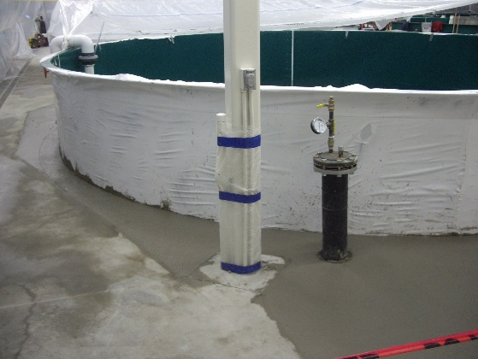
Floating Tanks
Notes:
June 22nd, the day of substantial completion the impossible happened. Water overflowed and overcame the trench drains in the area, two tanks that had yet been caulked around became buoyant and popped up out of the ground. Working as a team, we were able to procure, remove and replace tanks and replace concrete by August 2nd. Team effort like we recovered from a natural disaster, helping each without question.

Slide 17
Early Incubation
Notes:
It wasn’t until the last half year of the project when F&G biologist recognized that if they could begin incubating eggs a couple months earlier than substantial completion of the new hatchery, they would gain an entire year of new fish production. Because of the relationships that were built along with the hatchery, the entire site committed to getting eggs early, which literally meant an accelerated and re-sequenced schedule for most of the process equipment site. The eggs had to have a continuous flow of perfectly controlled water, which meant early completion and commissioning of the water supply through the building, heating, and maintaining sanitary areas, including early use of the labs.

Slide 18
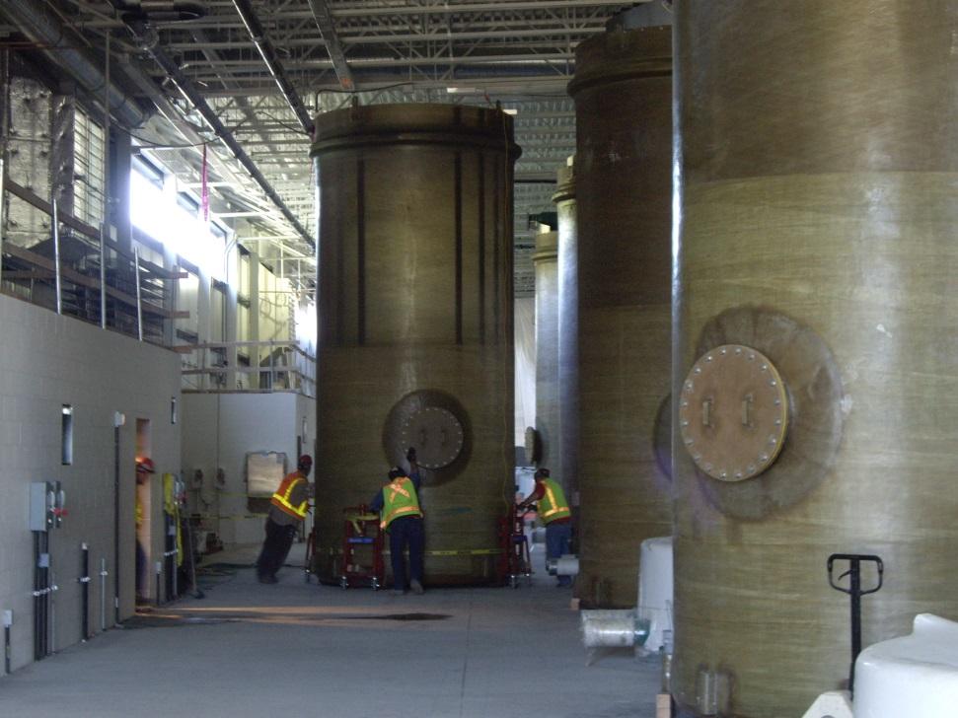
Bio Filters
Notes:
Because of the fast-track nature of the project, the 7000# bio-filters could not be fabricated and delivered in time before the building was closed in. The problem then became how do we get the tanks through a roll up door and stood up without crane access. After months of brainstorming, as a team we agreed upon a solution that, at the end of the day, was so simple that we all were very proud of how the teams commitment to solving issues without pointing fingers. Working together for the common good of the project and our client.
We

Slide 19
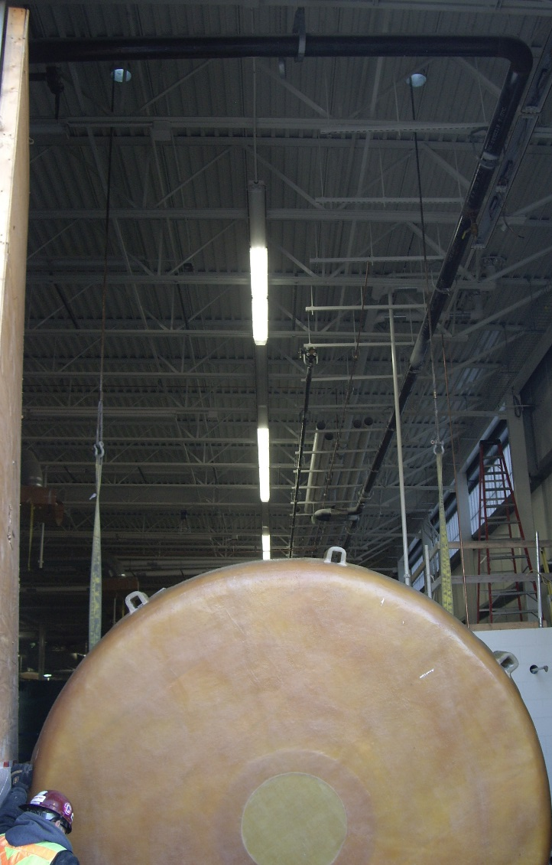
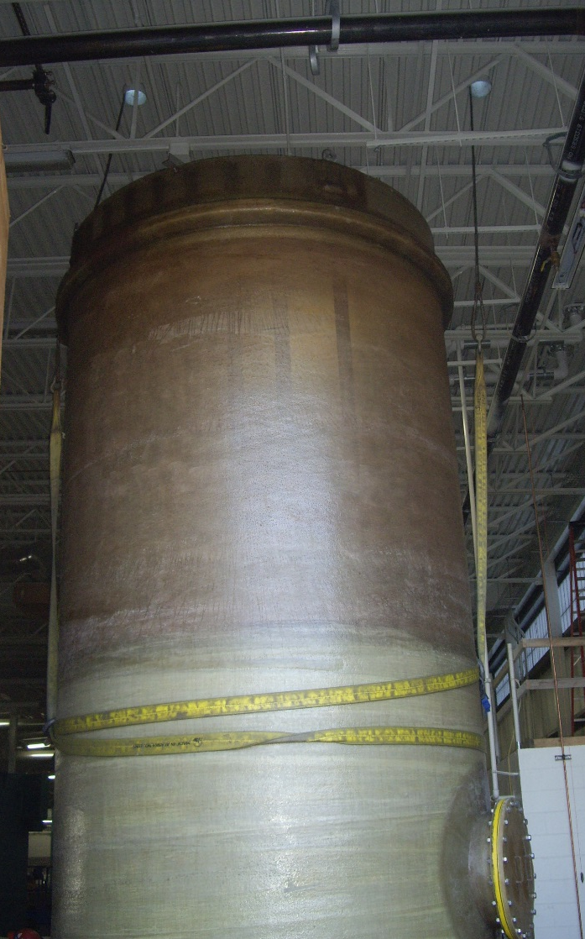
Notes:
We had to think outside the box, literally outside the building.
We had the roofer install short sleeves in the roof, that basically provided holes that the crane could use to access the load, and in this case the tanks from outside of the building.

Slide 20
Ox cart and project management
Notes:
Given a pair of oxen, a chart and a load to carry up a hill in a given amount of time. Everyone wants to add a little bundle-It’s such a big cart and these oxen are so strong…Environmental, art, social engineering, additional “small” projects, additional scope, etc etc. Near the top “Can we just cut off that tail the ox doesn’t really need that, how about those ears?

